Slide 1
Course Introduction
#

Slide 2

OBJECTIVES
Data-maturity model
dbt and data architectures
Data warehouses, data lakes, and lakehouses
ETL and ELT procedures
dbt fundamentals
Analytics Engineering

Slide 3
TOP-DOWN
Theory
1
Practice
2
Project
3

Slide 4
BOTTOM-UP
Theory
3
Project
2
Practice
1

Slide 5
Data Maturity Model
#

Slide 6
Maslow's Hierarchy of Needs
Self-actualization
5
Esteem Needs
4
Belongingness & Love Needs
3
Safety Needs
2
Physiological Needs
1

Slide 7
Data-Maturity Model
Artificial Intelligence
5
BI and Analytics
4
Data Integration
3
Data Wrangling
2
Data Collection
1

Slide 8
Typical Data Architecture
ML/AI/BI
4
Data Integration
3
Data Wrangling
2
Data Collection
1

Slide 9
Data Collection
Data Collection
1

Slide 10
Data Wrangling
Data Wrangling
2
Data Collection
1

Slide 11
Data Integration
Data Integration
3
Data Wrangling
2
Data Collection
1

Slide 12
ETL - ELT
#

Slide 13
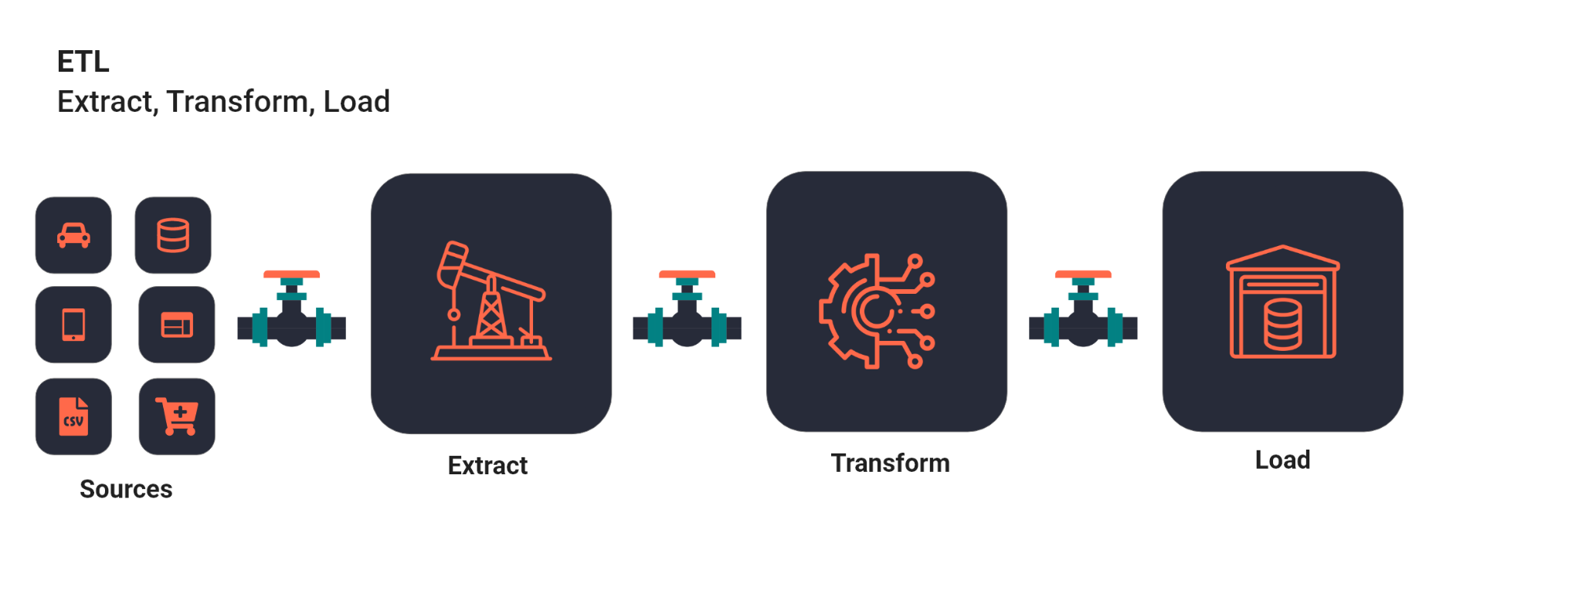
ETL

Slide 14
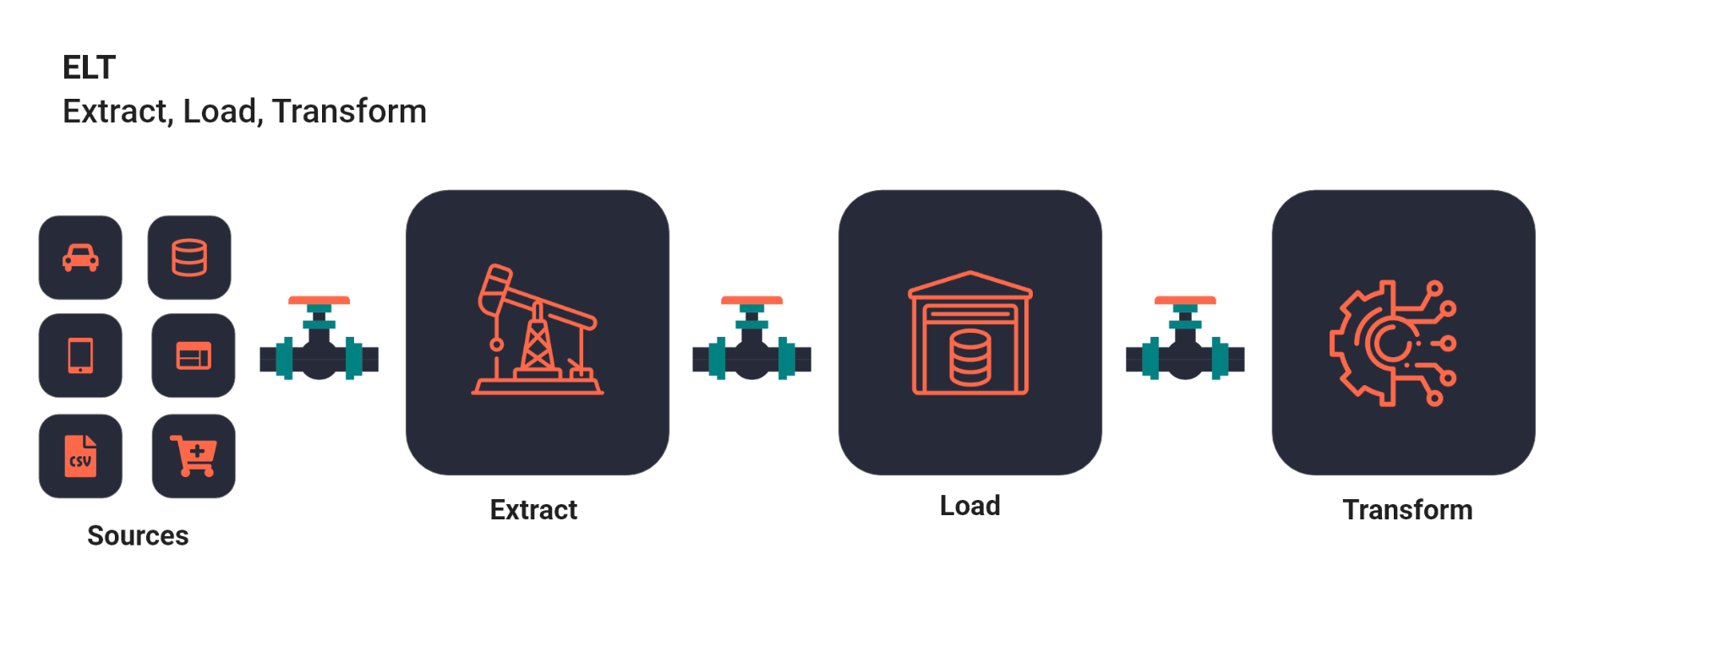
ELT

Slide 15
Data Warehouse
#

Slide 16
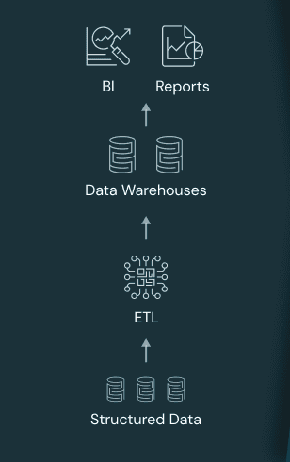








Data Warehouse
On-Premise
Cloud
PNG Credits: https://databricks.com/wp-content/uploads/2020/01/data-lakehouse-new-1024x538.png

Slide 17
External Tables
#

Slide 18




External Tables
External Tables
Data Lake

Slide 19
Data Lake
#

Slide 20
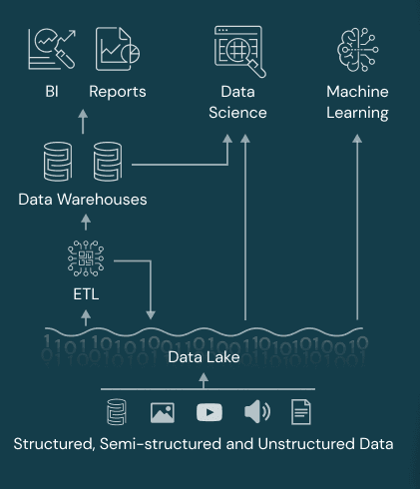



Data Lake
Unstructured / Structured / Semi-Structured Data
PNG Credits: https://databricks.com/wp-content/uploads/2020/01/data-lakehouse-new-1024x538.png

Slide 21
Data Lakehouse
#

Slide 22
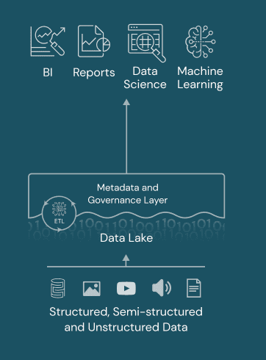
Data Lakehouse
PNG Credits: https://databricks.com/wp-content/uploads/2020/01/data-lakehouse-new-1024x538.png

Slide 23
Slowly Changing Dimensions
#

Slide 24
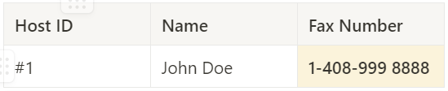
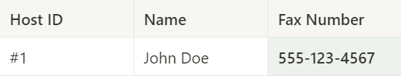
SCD Type 0
Not updating the DWH table when a Dimension changes
Source | DWH

Slide 25
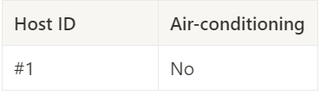
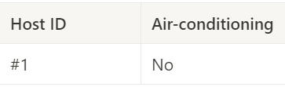
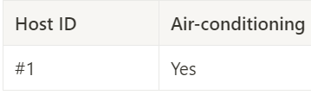
SCD Type 1
Updating the DWH table when a Dimension changes, overwriting the original data
Source | DWH
No Air-conditioning
Installed Air-conditioning
DWH updated

Slide 26
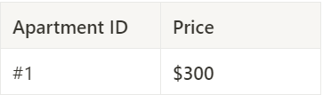
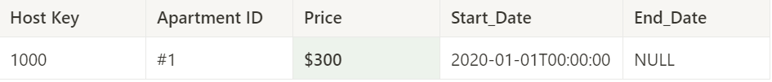
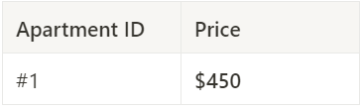
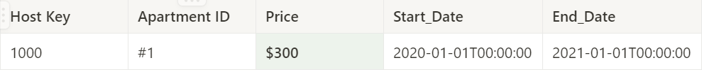
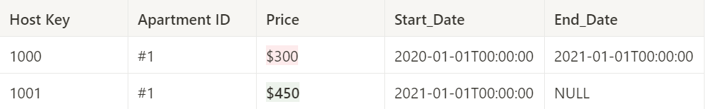
SCD Type 2
Keeping full history - Adding additional (historic data) rows for each dimension change
Source | DWH
Current rental price ($300)
Change in the rental price ($450)
DWH updated

Slide 27
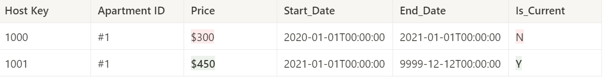
SCD Type 2
Keeping full history - Adding additional (historic data) rows for each dimension change
Source | DWH
Current rental price ($300)
Change in the rental price ($450)
DWH updated

Slide 28
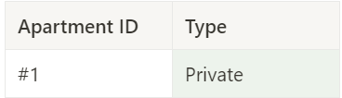
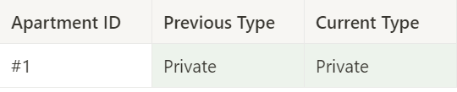
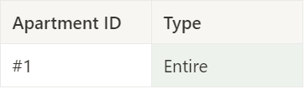

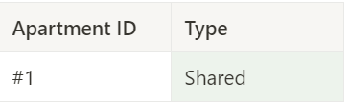
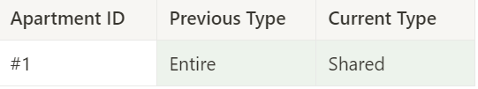
SCD Type 3
Keeping limited data history - adding separate columns for original and current value
Source | DWH
Listed as Private
Host changed Private to Entire
Host changed Entire to Shared

Slide 29
dbt Overview
#

Slide 30
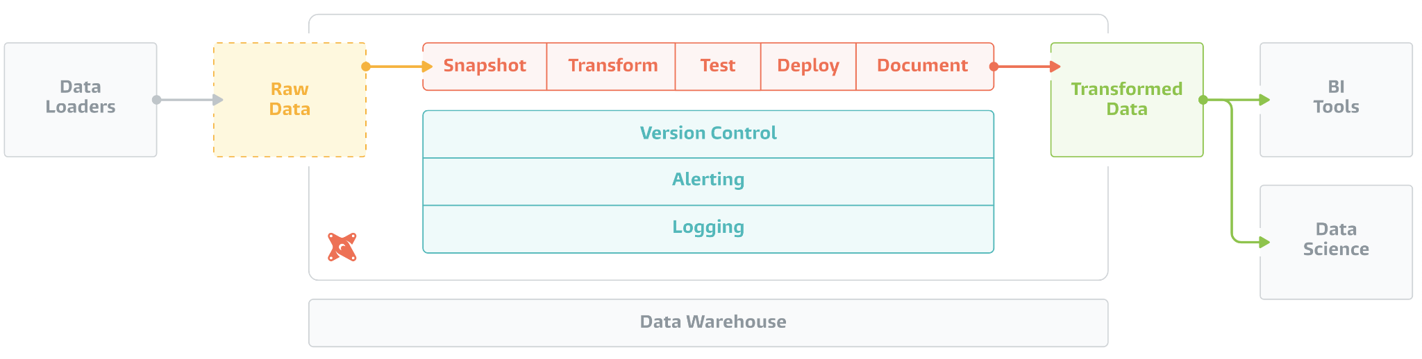
dbt Overview
PNG Credits: https://data.solita.fi/wp-content/uploads/2021/06/dbt-transform.png

Slide 31
Analytics Engineering
#

Slide 32
Common Table Expression (CTE)
#

Slide 33
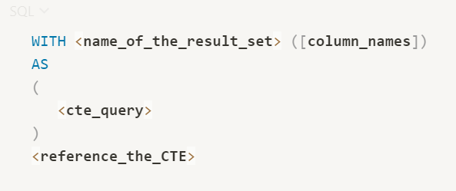
CTE
Syntax

Slide 34
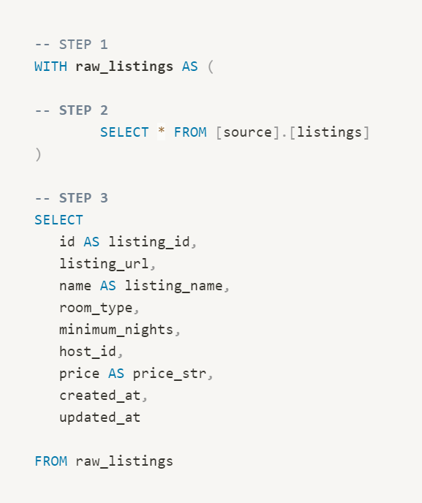
CTE
Example

Slide 35
PROJECT OVERVIEW
Analytics Engineering with Airbnb

Slide 36

ANALYTICS ENGINEERING WITH AIRBNB
Simulating the life of an Analytics Engineer in Airbnb
Loading, Cleansing, Exposing data
Writing test, automations and documentation
Data source: Inside Airbnb: Berlin

Slide 37



TECH STACK

Slide 38
REQUIREMENTS
Modeling changes are easy to follow and revert
Explicit dependencies between models
Explore dependencies between models
Data quality tests
Error reporting
Incremental load of fact tables
Track history of dimension tables
Easy-to-access documentation

Slide 39
NEXT STEPS - SETUP
Snowflake registration
Dataset import
dbt installation
dbt setup, snowflake connection
That’s it :)

Slide 40
SNOWFLAKE
Trial Account Setup

Slide 41
SNOWFLAKE AUTHENTICATION
❌ Username & Password + Multi-Factor Authentication Application
❌ Personal Access Token (Requires Network Policies)
❌ Single Sign-On (SSO)
✅ Keypair-Based Authentication

Slide 42
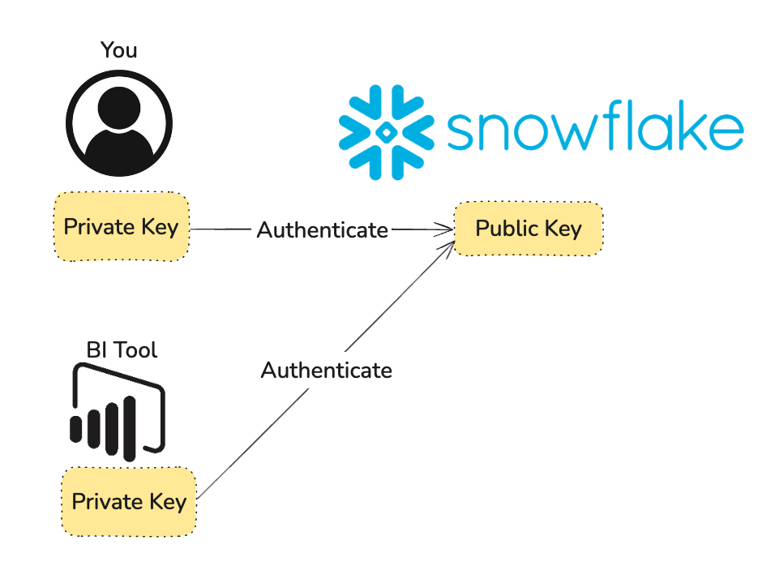
Public-Key Authentication (PKI)

Slide 43
SNOWFLAKE AUTO-SETUP APP
Imports the database tables: listings, hosts, reviews
dbt Snowflake user creation and permissions setup
Preset user creation and permission setup
https://dbtsetup.nordquant.com

Slide 44
DATA FLOW
Overview

Slide 45
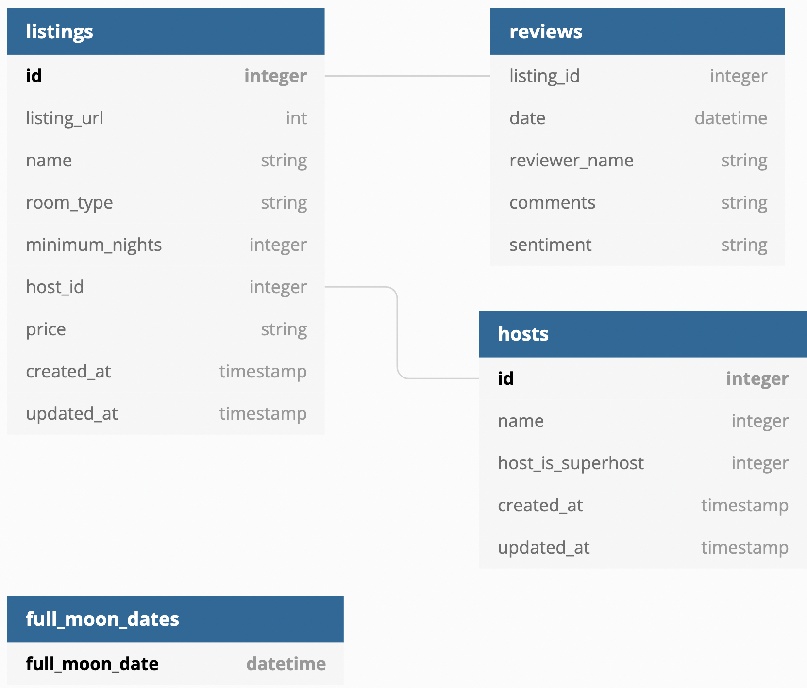
INPUT DATA MODEL

Slide 46
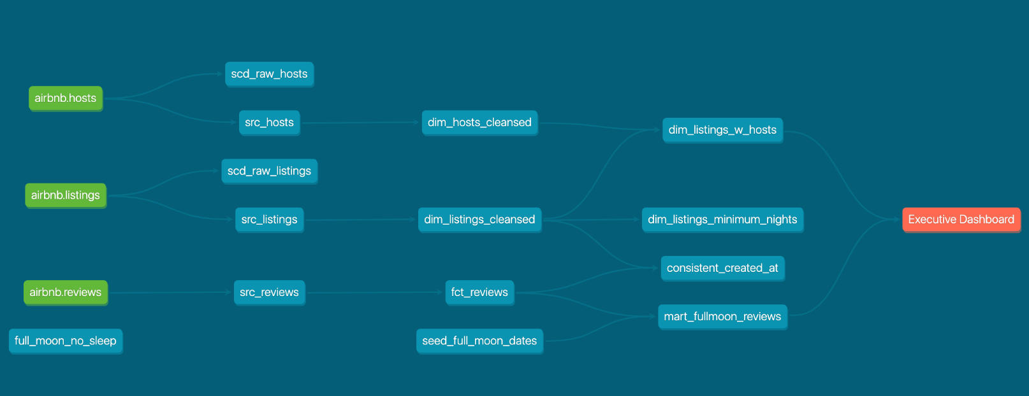
DATA FLOW OVERVIEW

Slide 47
DATA FLOW OVERVIEW
Raw layer
Staging Layer
Core Layer
Presentation Layer
raw_listings
src_listings
basic checks
Hosts: cleansed
Listings mart table
raw_hosts
src_hosts
basic checks
Listings:
cleansed
Reviews mart table
raw_reviews
src_reviews:
basic checks
Reviews: cleansed

Slide 48
DBT INSTALLATION

Slide 49
Requirements
Python
Git
Github account
Visual Studio Code
uv - a Python Package Manager - We’ll install it together

Slide 50
Steps
Fork the Student Repository on GitHub
Import the Student Repository into Visual Studio Code
Install uv
Install dbt

Slide 51
DBT SETUP
dbt init and connecting to Snowflake

Slide 52
SNOWFLAKE CONNECTION ISSUES?
Ensure VPN is switched off
Ensure you are not behind a corporate proxy or firewall
Try to change network or laptop

Slide 53
VSCode Extensions

Slide 54
dbt Visual Studio Code Extensions
The official VSCode Extension from dbt Labs.
Completely built from ground-up for dbt Fusion
This is the official extension
The dbt Power User extension from altimate.ai
Third-party extension
Supports both dbt Core and dbt Fusion

Slide 55
Extensions - Feature Comparison
 | official dbt Extension | dbt Power User
Price | Free until 15 users requires registration after 14 days | Freemium most features free, more advanced features require a subscription
Official | ✅ | ❌
dbt core Support | ❌ | ✅
dbt Fusion Support | ✅ | ✅
dbt Cloud Platform Support | ✅ | ✅
Code Quality / Helper | ✅ | ✅
Data Lineage | ✅ | ✅
AI Features | ❌ | ✅

Slide 56
Extensions / Now or Later?
The extension-related courseware assumes that you’ve completed the core part of the course
I’d suggest you give the course a shot using bare-bones Visual Studio Code to maximise your learning (It will hurt more, I know)
If you want to try the extensions now, I’ve created two codespaces for you - these have the code and extensions pre-installed:
  Official Extension
  dbt Power User
Codespace links in the Course Resources Repo

Slide 57
MODELS

Slide 58
LEARNING OBJECTIVES
Understand the data flow of our project
Understand the concept of Models in dbt
Create three basic models:
  src_listings
  src_reviews: guided exercises
  src_hosts: individual lab

Slide 59
MODELS OVERVIEW
Models are the basic building block of your business logic
Materialized as tables, views, etc…
They live in SQL files in the `models` folder
Models can reference each other and use templates and macros

Slide 60
DATA FLOW PROGRESS
Raw layer
Staging Layer
raw_listings
src_listings
basic checks
raw_hosts
src_hosts
basic checks
raw_reviews
src_reviews
basic checks

Slide 61
GUIDED EXERCISE
src_reviews.sql
Create a new model in the `models/src/` folder called `src_reviews.sql`.
Use a CTE to reference the AIRBNB.RAW.RAW_REVIEWS table
SELECT every column and every record, and rename the following columns:
  date to review_date
  comments to review_text
  sentiment to review_sentiment
Execute `dbt run` and verify that your model has been created
(You can find the solution among the resources)

Slide 62
MATERIALIZATIONS

Slide 63
LEARNING OBJECTIVES
Understand how models can be connected
Understand the four built-in materializations
Understand how materializations can be configured on the file and project level
Use dbt run with extra parameters

Slide 64
MATERIALIZATIONS

Slide 65
MATERIALISATIONS OVERVIEW
View
Use it
- You want a lightweight representation
- You don’t reuse data too often
Don’t use it
- You read from the same model several times
Table
Use it
- You read from this model repeatedly
Don’t use it
- Building single-use models
- Your model is populated incrementally
Incremental
(table appends)
Use it
- Fact tables
- Appends to tables
Don’t use it
- You want to update historical records
Ephemeral
(CTEs)
Use it
- You merely want an alias to your date
Don’t use it
- You read from the same model several times

Slide 66
DATA FLOW PROGRESS
Raw layer
Staging Layer
Core Layer
raw_listings
src_listings
basic checks
dim_listings_cleansed
cleansing
dim_listings_with_hosts
final dimension table
raw_hosts
src_hosts
basic checks
dim_hosts_cleansed
cleansing
raw_reviews
src_reviews
basic checks
fct_reviews
incremental

Slide 67
GUIDED EXERCISE
dim_hosts_cleansed.sql
Create a new model in the `models/dim/` folder called `dim_hosts_cleansed.sql`.
Use a CTE to reference the `src_hosts` model
SELECT every column and every record, and add a cleansing step to host_name:
  If host_name is not null, keep the original value
  If host_name is null, replace it with the value ‘Anonymous’
  Use the NVL(column_name, default_null_value) function
Execute `dbt run` and verify that your model has been created
(You can find the solution among the resources)

Slide 68
INCREMENTAL STRATEGIES
append
Pros
- Simplest
- Fully-transparent logic
Cons
- No duplicate checks
merge
Pros
- Idempotent
(no duplicates)
- Updates existing records
- Snowflake/BigQuery default
Cons
- Slower
- Requires unique_key
delete+insert
Pros
- Works on DWHs with no MERGE support
- Simple mental model
Cons
- Two operations
- Requires unique_key
insert_overwite
Use it
- Fast for partitioned tables
Cons
- Requires Partitioned table
- All or nothing (replaces whole partitions)
+microbatch

Slide 69
SOURCES & SEEDS

Slide 70
LEARNING OBJECTIVES
Understand the difference between seeds and sources
Understand source-freshness
Integrate sources into our project

Slide 71
SOURCES AND SEEDS OVERVIEW
Seeds are local files that you upload to the data warehouse from dbt
Sources is an abstraction layer on the top of your input tables
Source freshness can be checked automatically

Slide 72
SNAPSHOTS

Slide 73
LEARNING OBJECTIVES
Understand how dbt handles type-2 slowly changing dimensions
Understand snapshot strategies
Learn how to create snapshots on top of our listings and hosts models

Slide 74
SNAPSHOTS
Overview

Slide 75
TYPE-2 SLOWLY CHANGING DIMENSIONS
host_id | host_name | email
1 | Alice | alice.airbnb@gmail.com
2 | Bob | bob.airbnb@gmail.com

Slide 76
TYPE-2 SLOWLY CHANGING DIMENSIONS
host_id | host_name | email
1 | Alice | alice.airbnb@gmail.com
2 | Bob | bobs.new.address@gmail.com

Slide 77
TYPE-2 SLOWLY CHANGING DIMENSIONS
host_id | host_name | email | dbt_valid_from | dbt_valid_to
1 | Alice | alice.airbnb@gmail.com | 2022-01-01 00:00:00 | null
2 | Bob | bob.airbnb@gmail.com | 2022-01-01 00:00:00 | 2022-03-01 12:53:20
3 | Bob | bobs.new.address@gmail.com | 2022-03-01 12:53:20 | null

Slide 78
CONFIGURATION AND STRATEGIES
Snapshots live in the snapshots folder
Strategies:
  Timestamp: A unique key and an updated_at field is defined on the source model. These columns are used for determining changes.
  Check: Any change in a set of columns (or all columns) will be picked
  up as an update.

Slide 79
GUIDED EXERCISE
raw_hosts_snapshot.yml
Create a new snapshot in the `snapshots/` folder called `raw_hosts_snapshot.yml`.
Call it scd_raw_hosts
Set the target table name to the hosts source table
Use the timestamp strategy, figure out the unique key and updated_at column to use
Invalidate hard deletes
Execute `dbt snapshot` and verify that your snapshot has been created
(You can find the solution among the resources)

Slide 80
TESTS

Slide 81
LEARNING OBJECTIVES
Understand Unit Tests and Data Tests
Understand how these tests can be defined
Configure built-in generic Data Tests
Create your own singular Data Tests
Create Unit Tests for your data

Slide 82
TESTS OVERVIEW
dbt has two types of tests: Unit Tests and Data Tests and it supports Contracts
Unit Tests test transformations with a small sample of mock data you provide
Data Tests test data integrity and quality on the actual data
Contracts enforce the schema of models
(such as column names, types and constraints)

Slide 83
DATA TESTS OVERVIEW
There are two types of data tests: singular and generic
There are four built-in generic tests:
  unique
  not_null
  accepted_values
  Relationships
Singular data tests are SQL queries stored in tests which are expected to return an empty result set
You can define your own custom generic tests
You can import tests from dbt packages (will discuss later)

Slide 84
GUIDED EXERCISE
TEST dim_hosts_cleansed
Create a generic data test for the `dim_hosts_cleansed` model.
host_id: Unique values, no nulls
host_name shouldn’t contain any null values
Is_superhost should only contain the values t and f.
Execute `dbt test` to verify that your tests are passing
Bonus: Figure out which tests to write for `fct_reviews` and implement them
(You can find the solution among the resources)

Slide 85
CONSTRAINTS
Run tests at insert time
An enforced contract must be defined to make constraints work.
Only works on table and incremental materializations
Functionality heavily depends on platform. Theoretically you can test for primary_key, foreign key, check, not_null, unique
Only a fraction of these are enforced in Snowflake at the time of recording: not_null

Slide 86
JINJA AND MACROS

Slide 87
LEARNING OBJECTIVES
Understand the basic building blocks and control structures of Jinja
Use macros to add new functionality to your project

Slide 88
JINJA
A templating language that lets you write dynamic, reusable SQL code.
Think of it as "programming inside your SQL" - you can use:
Variables
Conditionals and Loops
Functions
Macros

Slide 89
JINJA - BASIC BUILDING BLOCKS
Comments: {# This is a comment #}
  Instantly removed - won’t appear anywhere
Statements: {% set my_name = "Zoltan" %}
Expressions: {{ my_name }}
  Outputs “Zoltan”

Slide 90
(SOME) BUILT-IN VARIABLES IN DBT
{{ this }}
  References the model being built
{{ target.name }}
  The name of our target - the default is defined in dbt_profiles.yml (dev)
{{ target.database }}
  The target database
{{ target.schema }}
  The target schema

Slide 91
JINJA - MACRO (FUNCTION) EXAMPLES
{{ log("Debug message", info=True) }} Prints to the console
{{ var("user_name") }} Get variable value
{{ ref('dim_listings_cleansed') }} References another model - dbt specific
{{ source('airbnb', 'listings') }} References a source table - dbt specific
{{ config('dim_listings_cleansed') }} References another model - dbt specific
{{ adapter.get_columns_in_relation }} Adapter-level functionality - dbt specific

Slide 92
MACROS (FUNCTIONS) IN DBT
Macros are jinja macros created in the macros folder
There are many built-in macros in DBT
You can use macros in various places, such as:
  model definitions
  tests
  other macros

Slide 93
CUSTOM BUILDING BLOCKS IN DBT
{% test … %} Test Definition
{% snapshot %} Snapshot definition
{% docs %} Documentation block
{% materialization %} Custom materialization

Slide 94
JINJA - DEFINING MACROS
{% macro select_positive_values(model, column_name) %}
SELECT *
FROM {{ model }}
WHERE {{ column_name }} > 0
{% endmacro %}

Slide 95
JINJA - IF/ELSE
SELECT * FROM {{ ref('src_reviews') }} WHERE review_text IS NOT NULL
{% if is_incremental() %}
AND review_date > (SELECT MAX(review_date) FROM {{ this }})
{{ log('Loading incrementally - new reviews only', info=True) }}
{% else %}
{{ log('Loading all reviews - first run or full refresh', info=True) }}
{% endif %}

Slide 96
JINJA - LOOPS
{% set columns = ['listing_id', 'listing_name', 'price'] %}
SELECT
{% for col in columns %}
{{ col }}{% if not loop.last %}, {% endif %}
{% endfor %}
FROM {{ ref('dim_listings_cleansed') }}

Slide 97
WHITESPACE CONTROL
{% statement %}: No whitespace control
{%- statement %}: Strip whitespace BEFORE
{% statement -%}: Strip whitespace AFTER
{%- statement -%} Strip whitespace BEFORE and AFTER

Slide 98
JINJA, CUSTOM TESTS AND PACKAGES

Slide 99
LEARNING OBJECTIVES
Understand how macros are created
Use macros to implement your own generic tests
Find and install third-party dbt packages

Slide 100
MACROS, CUSTOM TESTS AND PACKAGES
Macros are jinja templates created in the macros folder
There are many built-in macros in DBT
You can use macros in model definitions and tests
A special macro, called test, can be used for implementing your own generic tests
dbt packages can be installed easily to get access to a plethora of macros and tests

Slide 101
DOCUMENTATION

Slide 102
LEARNING OBJECTIVES
Understand how to document models
Use the documentation generator and server
Add assets and markdown to the documentation
Discuss dev vs. production documentation serving

Slide 103
DOCUMENTATION OVERVIEW
Documentations can be defined two ways:
  In yaml files (like schema.yml)
  In standalone markdown files
Dbt ships with a lightweight documentation web server
For customizing the landing page, a special file, overview.md is used
You can add your own assets (like images) to a special project folder

Slide 104
ANALYSES, HOOKS AND EXPOSURES

Slide 105
LEARNING OBJECTIVES
Understand how to store ad-hoc analytical queries in dbt
Work with dbt hooks to manage table permissions
Build a dashboard in Preset
Create a dbt exposure to document the dashboard

Slide 106
HOOKS
Hooks are SQLs that are executed at predefined times
Hooks can be configured on the project, subfolder, or model level
Hook types:
  on_run_start: executed at the start of dbt {run, seed, snapshot}
  on_run_end: executed at the end of dbt {run, seed, snapshot}
  pre-hook: executed before a model/seed/snapshot is built
  post-hook: executed after a model/seed/snapshot is built

Slide 107
DEBUGGING WORKFLOWS

Slide 108
Commands for debugging
Command | dbt Core | dbt Fusion
dbt --version | dbt command available?
dbt debug | Warehouse connection
dbt clean | Clear target folder
dbt ls | What models can dbt see
dbt deps | Packages available?
dbt parse | Validate YAML, write manifest.json
dbt compile | Render Jinja -> SQL | Also checks SQL syntax
dbt run | Run/Materialize the model
dbt test | Run tests
dbt show | What would a model produce?
dbt build | Runs dbt seed, dbt run, dbt snapshot, dbt test in order

Slide 109
Commands for debugging
How can we make debugging the full pipeline faster?
Command | dbt Core | dbt Fusion
dbt run --empty | Practically executed dbt run with LIMIT 0 on all models
dbt run --sample <time expression> | Samples data based on a time range

Slide 110
Selectors
By name | -s model_name, -s path | Select a model or path
Graph Operators | +model, model+, @model | Selects a subgraph from DAG
Methods | tag:, source:, path: | Selects by type or other property
State | state:new, state:modified | Comparing my DAG to another DAG
Result | Result:error, result:fail, … | Rerun only what failed (tests, models, etc)
Set operators | <s-a> <s-b>, <s-a>,<s-b> | Union or Intersection of selectors
Exclusion | –exclude <s> | Exclude models included in selector
“Selectors” | Combining selectors in YAML | Saving common selector criterias

Slide 111
PYTHON MODELS

Slide 112
Python Models
Expressing a transformation as Python code
Only necessary for a small, advanced set of use cases.
The code runs on the target platform
A subset of data platforms supported, i.e.:
  Databricks
  Snowflake
  BigQuery
Limitations:
  Usually much slower as SQL transformations
  Syntax not platform-agnostic

Slide 113
Python Models - syntax
def model(dbt, session):
dt.ref(“model_name”) # referencing models
# Your transformations
# returns either a Pandas or platform-specific DataFrame
return df
dbt: dbt Functionalities (refs, sources, variables, … )
session: Target-platform-specific functionalities (i.e. accessing built-in functions)

Slide 114
Advanced Python Models
Materialization can be specified (table and incremental)
  view and ephemeral materializations not supported
Python packages can be requested to be installed
dbt configuration, variables, etc accessible through the dbt object
Custom SQL can be executed within from within the function

Slide 115
MODEL LIFECYCLE

Slide 116
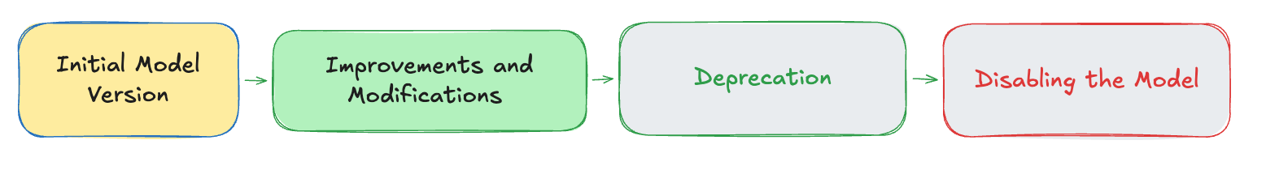
Model Lifecycle

Slide 117
Model Lifecycle
Initial Model Version: You know this already :)
Improvements / Modifications:
  Modify in-place (⚠️ may break downstream models)
  Use Model Versions
Deprecation: the deprecated configuration
Disabling a model: the enabled configuration

Slide 118
Model Versioning
Problem:
Changing the schema of a model is possible breaking downstream models, that are managed by others
dbt’ s Solution
Create a new version of the same model, keep the old.
Implement a flag to indicate the old model should be used by default
Downstream model updates reference the a specific version of the model explicitly

Slide 119
Model Versioning - File Names
Filename | Comment
dim_hosts_cleansed_v1.sql
dim_hosts_cleansed_v2.sql
dim_hosts_cleansed.sql | Use the defined_in attribute

Slide 120
dbt IN PRODUCTION

Slide 121
Slim CI - Learning Objectives
Working with different target warehouses and schemas
Using Environmental Variables
Working with state (new, modified, failed)
--defer and --clone
Implementing Slim CI through Pull Requests

Slide 122
Environment Variables
Passing values from the running environment (command line, CI tool, etc). Not the same as variables
{{ env_var(‘VARIABLE_NAME’, ‘default value’) }}

Slide 123
Working with Custom Schemas
Two schema configs affect each model:
Target schema (take a look at profiles.yml)
Model’s schema (by default this is empty)

Slide 124
Custom Schemas
By default scema = target.schema + _ + custom schema name:
I.e. if the model name is dim_listings
target.schema | custom schema name | Actual schema built
DEV | none | DEV.dim_listings
DEV | MYSCHEMA | DEV_MYSCHEMA.dim_listings
PROD | MYSCHEMA | PROD_MYSCHEMA.dim_listings
Confusing? generate_schema_name macro to the rescue!

Slide 125
Overriding the Schema
After implementing a production-grade configuration in generate_schema_name.sql
target.name | custom schema name | Actual schema built
prod | none | PROD.dim_listings
prod | MART | MART.dim_listings
staging | none | STAGING.dim_listings
staging | MART | STAGING_MART.dim_listings
myfeature | none | DBT_MYFEATURE.dim_listings
myfeature | MART | DBT_MYFEATURE_MART.dim_listings

Slide 126
Basic Concepts
Target: The warehouse / database / schema you are working on
CI: Test every change
CD: Ship/deploy every change
Slim CI: test only what changed (without rebuilding the whole pipeline)

Slide 127
dbt in Production - Slim CI
Problem
Rebuilding every model for each pull request can be slow
Solution
Materialize / test only models that have changed compared to the target branch of the PR
Use production tables as stand-ins for unmodified tables

Slide 128
Working with state
dbt stores state (model build state, source freshness, etc) in json files
State is stored in target/ by default (change this with --target-path)
Point dbt to another state folder with the --state parameter
Use case:
Store production state in a folder (possible in a cloud storage)
Make your changes (yml, SQL, etc.)
Point dbt to the production state so it knows what has been changed
And only rebuild what’s necessary

Slide 129
Working with the state selector
Use the state: parameter to
new | build new models only
modified | Build models modified (compared to target state)
modified.body | SQL body modified
modified.config | Config modified
… | Multiple selectors for fine-tuning state

Slide 130
--defer vs. --clone
Use --defer:
You want the cheapest possible option in CI
Doesn’t materialize any model besides the ones modified on the dev’s schema (it uses the “prod” schema as a stand-in for missing models)
Use --clone
You want a cheap full copy of the “prod” schema
Testing incremental models (defer would need --full-refresh)
Deployment: clone prod system to staging, test, deploy only if tests pass
Seeding dev environments

Slide 131
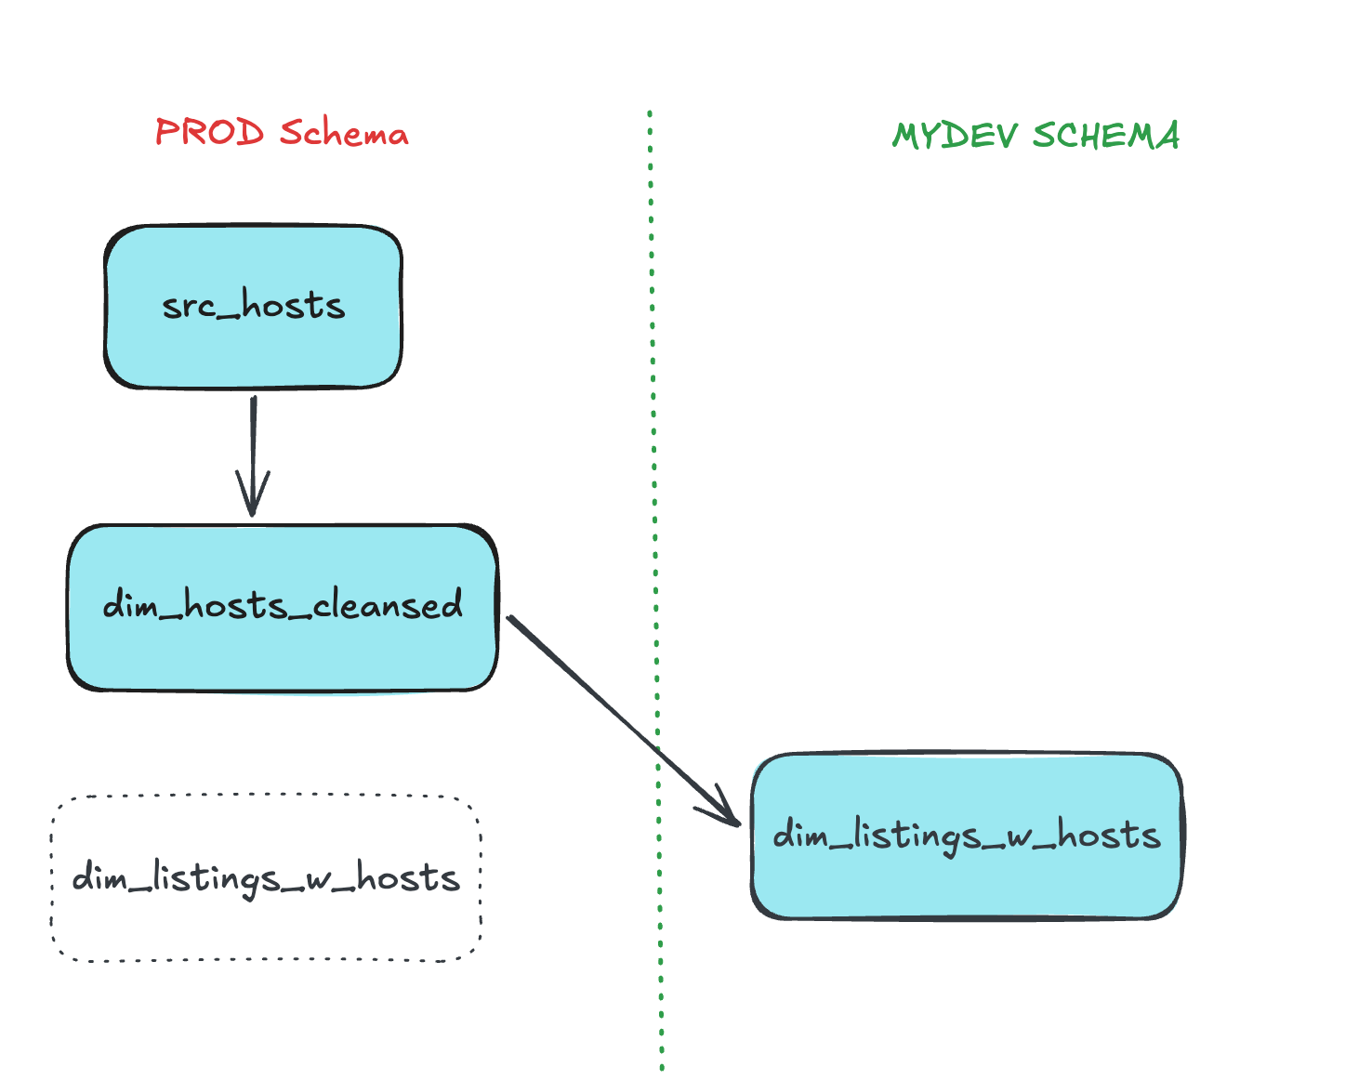
--defer

Slide 132
Git Concepts (oversimplified)
Commit: save a snapshot of your changes locally
Push: send your commits to the central repo
Branch: An independent line of work
  main: production-ready, deployed code
  feature branches: where analytics engineers do their work
Pull Request (PR): propose merging your branch into main

Slide 133
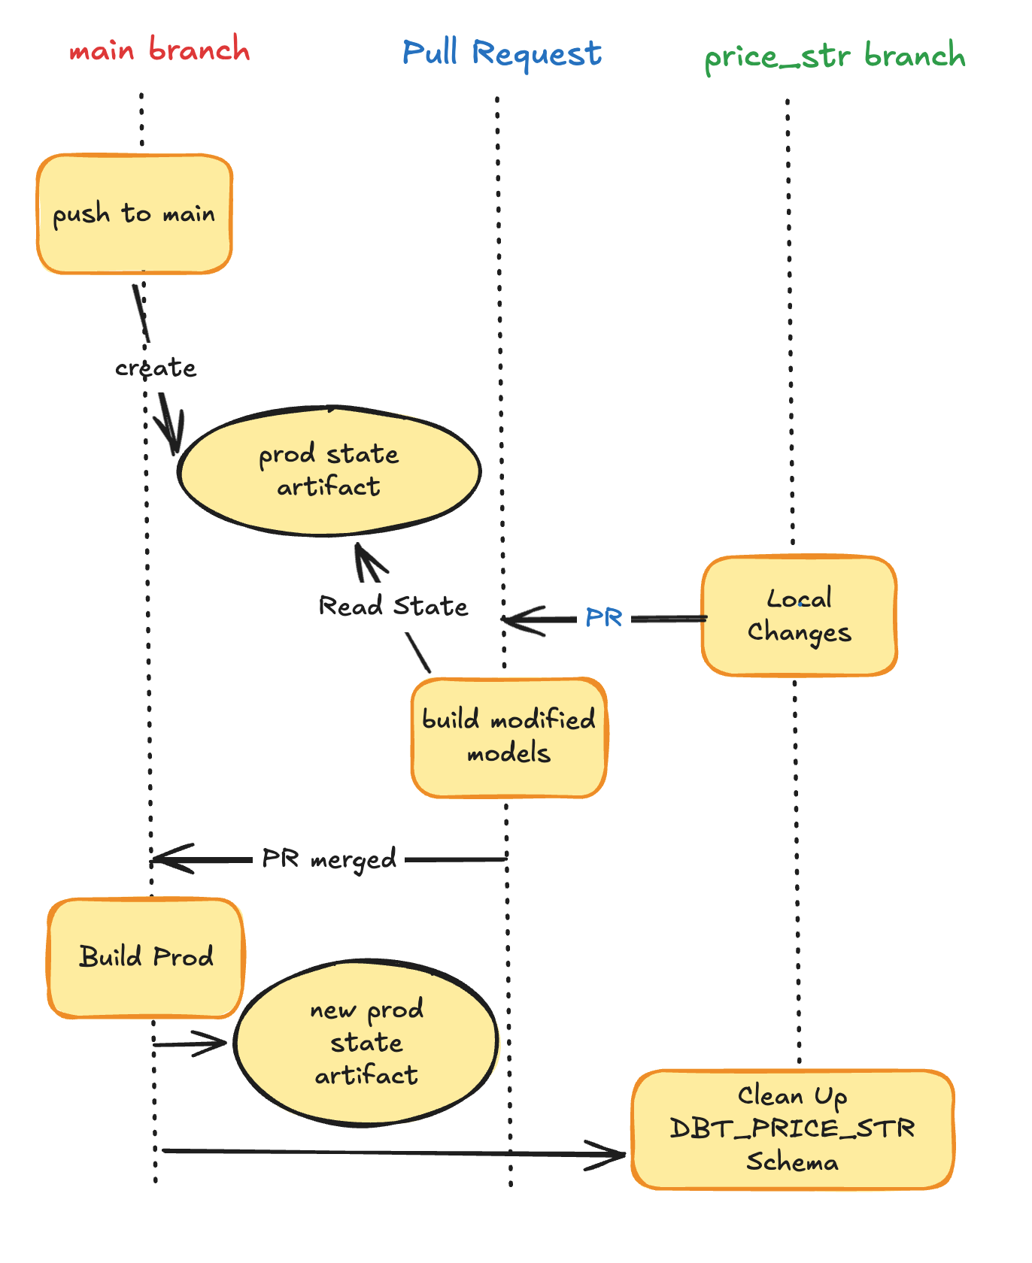
Slim CI
Three Workflows
Push to main: build everything and create prod-target artifact
Pull Request: build state:modified
Merged Pull Request:
  Implicit push to main
  Clean up development schema

Slide 134
dbt Fusion
&
The Official VSCode Extension

Slide 135
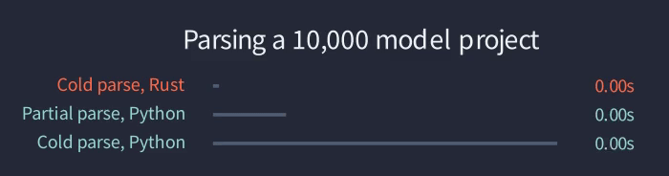
A new Engine for dbt
Completely rewritten from the ground up in Rust
  Magnitudes-Faster Parsing
  “Code Comprehension Engine”
Released as Source-available from dbt Labs
Released along an Official Visual Studio Code Extension

Slide 136
LEARNING OBJECTIVES
Understand how the Parser and Compiler work
Feature Matrix - dbt Fusion vs dbt Core
License differences
Get hands-on with dbt Fusion and the VSCode Extension

Slide 137
dbt Fusion
Technical Deep Dive

Slide 138
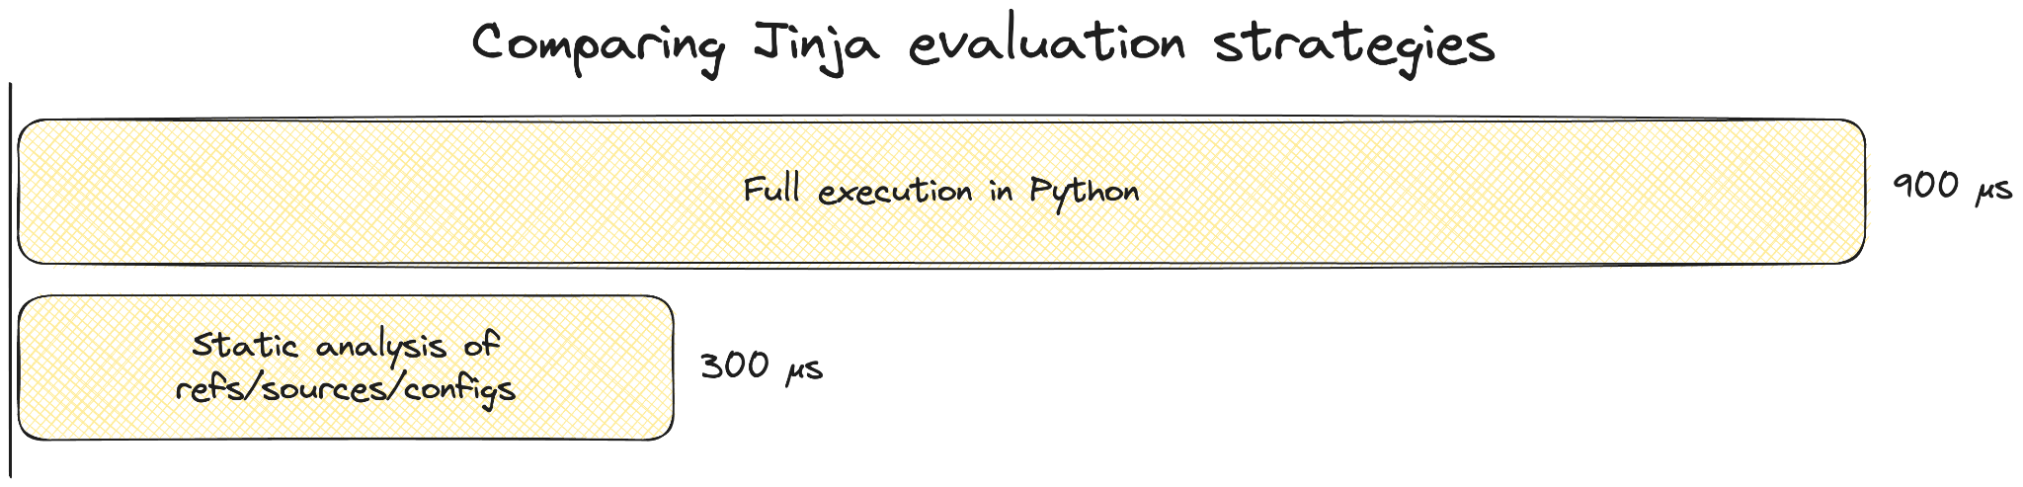
PARSING
Source: https://docs.getdbt.com/blog/faster-project-parsing-with-rust

Slide 139
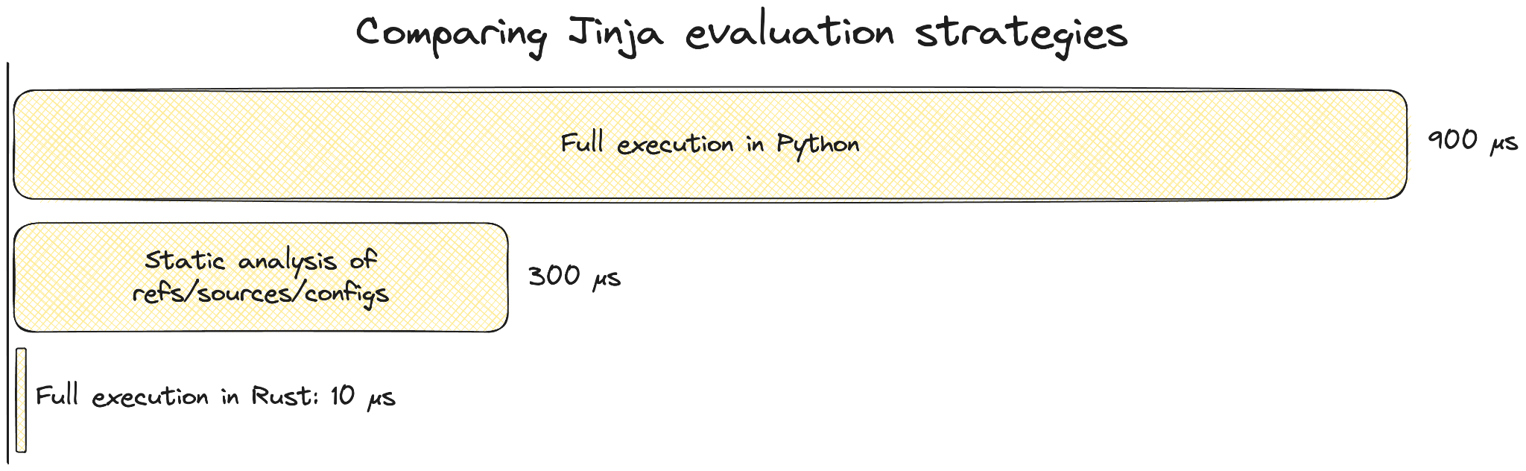
PARSING WITH RUST
Source: https://docs.getdbt.com/blog/faster-project-parsing-with-rust

Slide 140
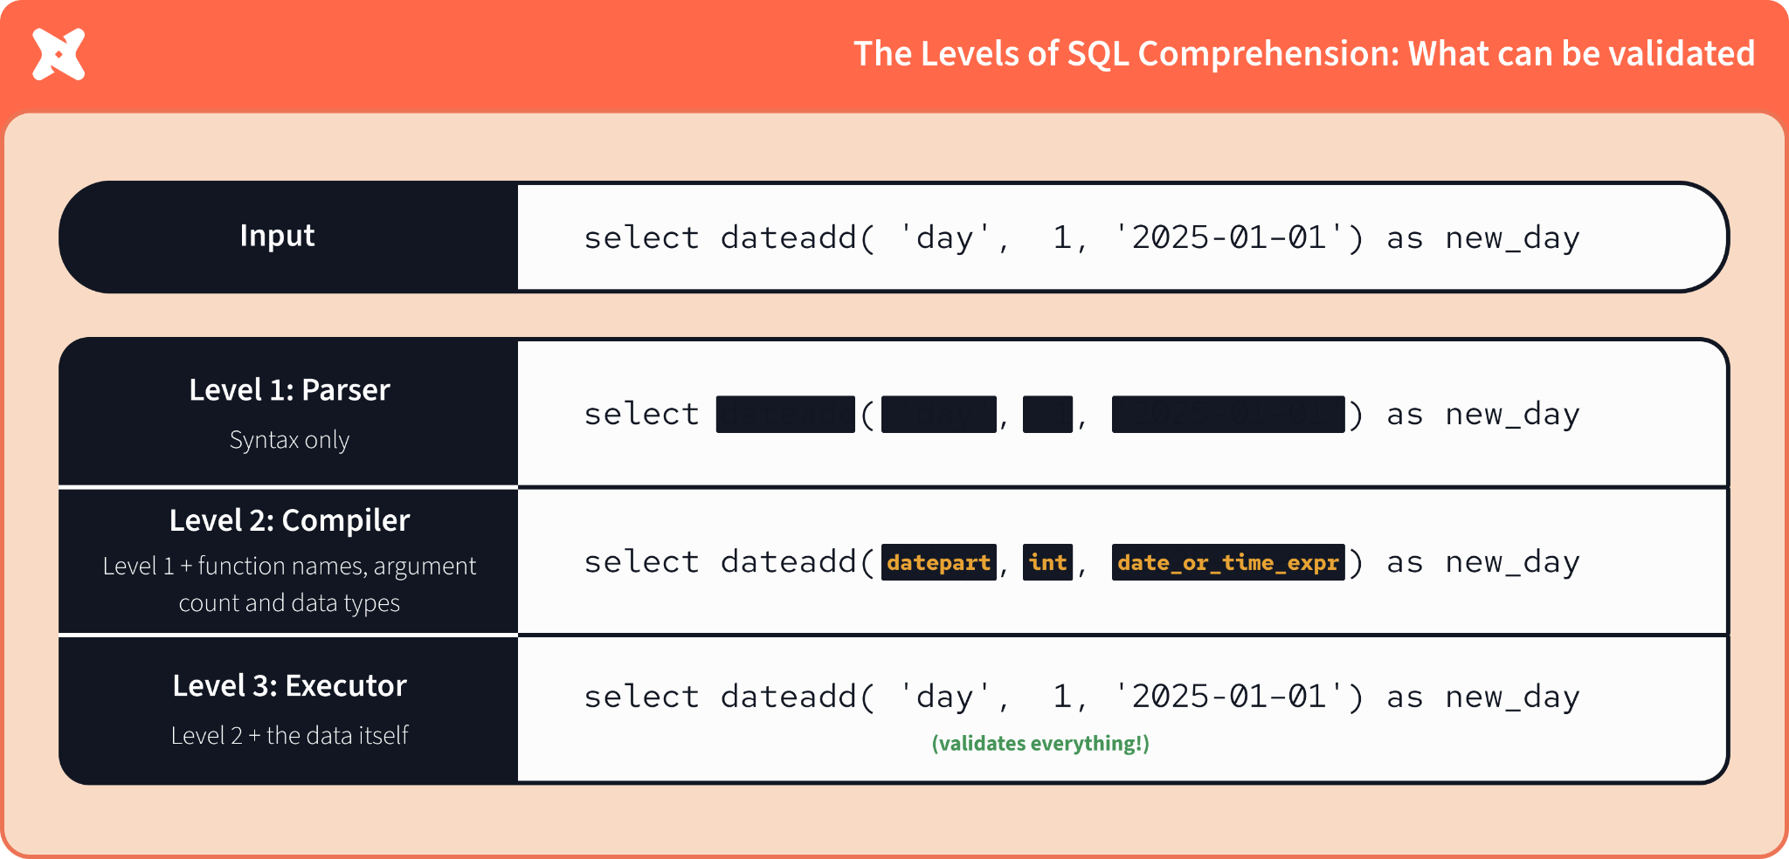
SQL COMPREHENSION
Source: https://docs.getdbt.com/blog/faster-project-parsing-with-rust

Slide 141
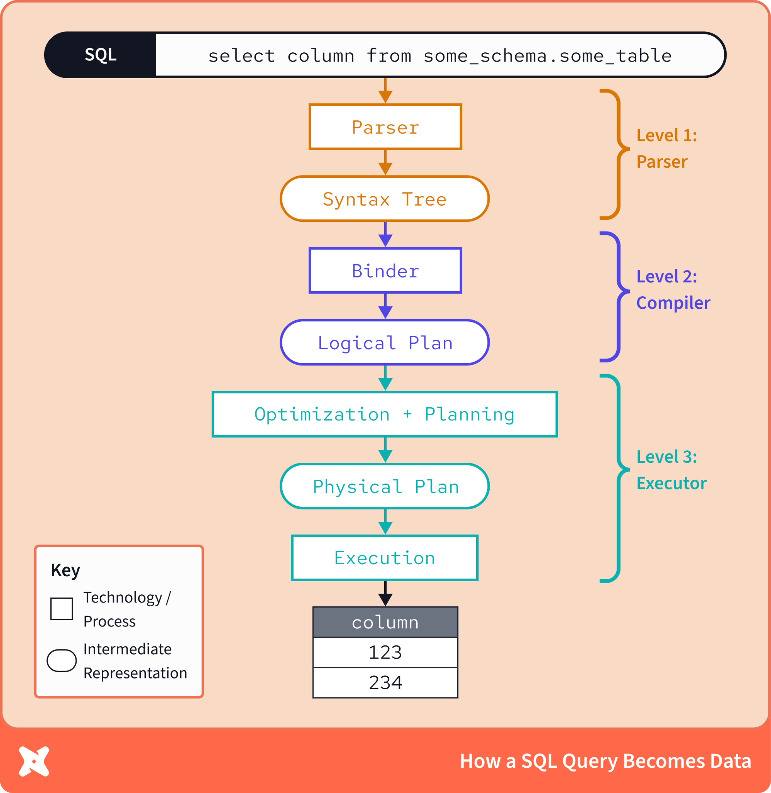
SQL COMPREHENSION
dbt Core: let the Data Warehouse
compile the SQL code
dbt Fusion: let’s compile and
comprehend as much
as possible without
touching the DWH
Source: https://docs.getdbt.com/blog/faster-project-parsing-with-rust

Slide 142
dbt Fusion License
dbt Core: Apache 2
dbt Fusion: Mostly Elastic License v2 (ELv2)
  You can use it for free, but you cannot provide it as a service for free
Might include proprietary licensed enterprise features later
For you most probably the license change won’t make a difference
Source: https://www.getdbt.com/licenses-faq

Slide 143
VISUAL STUDIO CODE EXTENSION
Let’s go ahead and install the VSCode Extension, which will:
Install dbt Fusion
Upgrade your dbt project to be 100% Fusion compatible
Compile your project for SQL Comprehension

Slide 144
HERO

Slide 145
ORCHESTRATION

Slide 146





THE ORCHESTRATION LANDSCAPE
Cloud

Slide 147
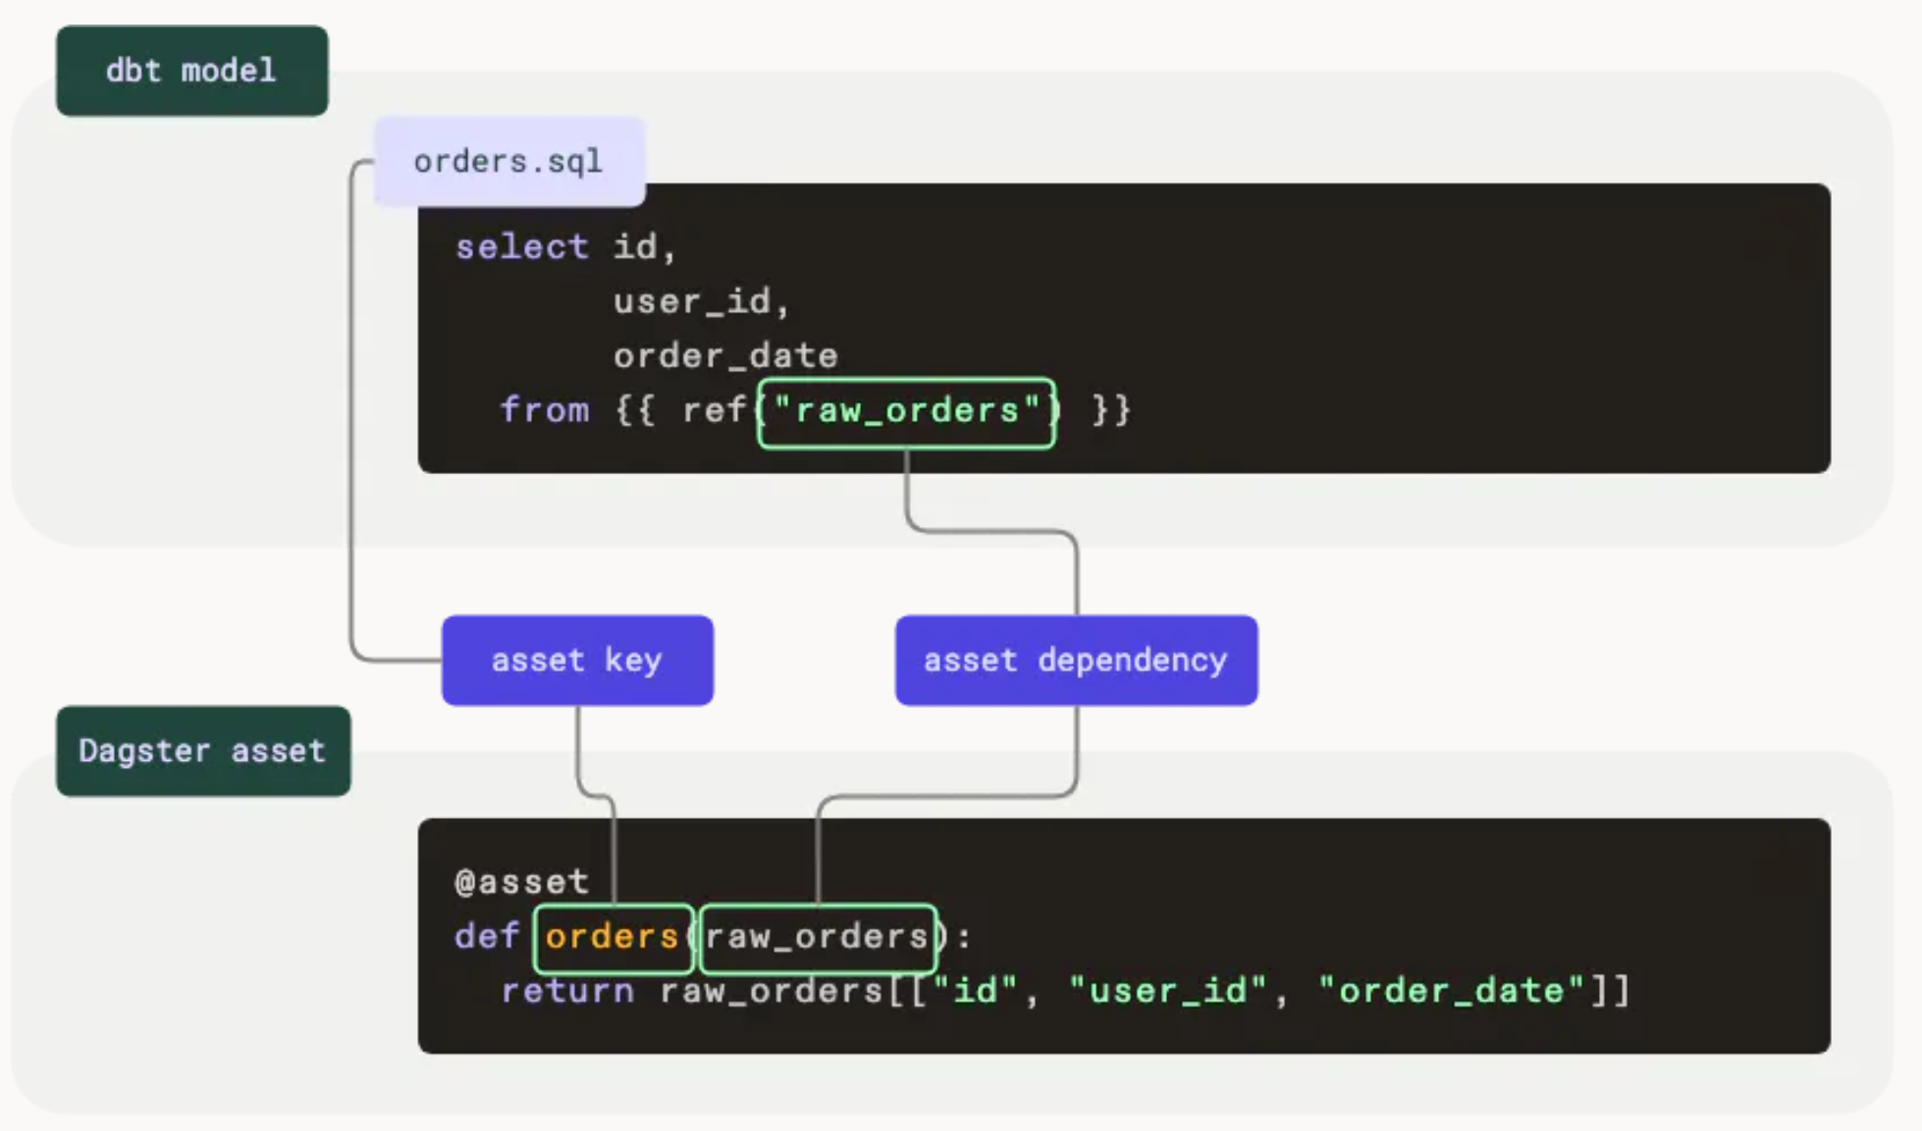
DAGSTER - SIMILAR DATA CONCEPTS
Image source: https://docs.dagster.io/integrations/dbt

Slide 148
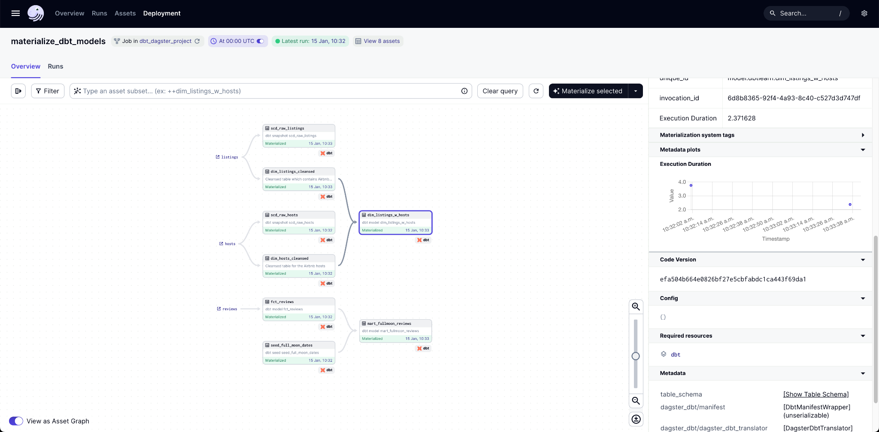
GREAT UI
Image source: https://docs.dagster.io/integrations/dbt

Slide 149
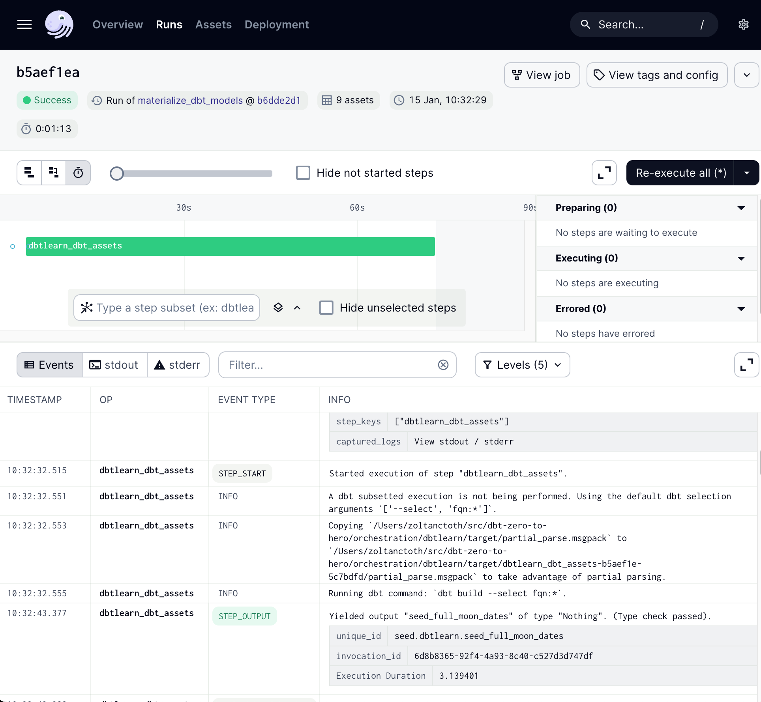
EASY TO DEBUG
Image source: https://docs.dagster.io/integrations/dbt

Slide 150
Capstone Project
Let’s implement a real-world pipeline end to end on your own
Clone the repo
Get to know the data
Read the instructions and solve the assignment
My solution: Solutions link
If you started the course before 14 Mar 2025, go to dbtsetup.nordquant.com and go follow the instructions at the “Capstone-only Setup” tab before you start.

Slide 151
CONGRATS!

Slide 152
FROM THIS POINT THE SLIDES ARE WORK IN PROGRESS

